Slide 1
Metal Reactions with Acid

Slide 2
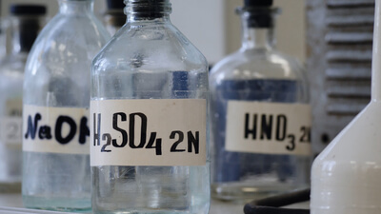
By the end of this lesson you should be able to:
Write equations to describe reactions between metals and both dilute hydrochloric acid and sulfuric acid.
Describe the observations of selected metals when they react with dilute acids.
Discuss how a metal’s reactivity with dilute acids can determine how it is used.

Slide 3
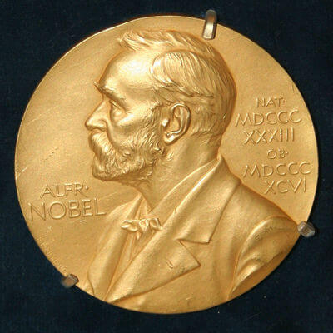
Dissolving Gold
Gold is one of the least reactive metals; it is even less reactive than silver and does not react with dilute acids. However, a mixture of hydrochloric and nitric acid called Aqua Regia will dissolve gold into a solution.
The Nobel Prize medals of two German scientists, (Max von Laue and James Franck) were sent to Denmark for safe keeping during World War II. When Germany invaded Denmark, the medals were dissolved in Aqua Regia to prevent them from being confiscated.
The solution was stored on a shelf alongside other chemicals and was safely hidden during the war. When the war was over, the gold was recovered from the solution and the medals were recast and returned to the scientists.

Slide 4
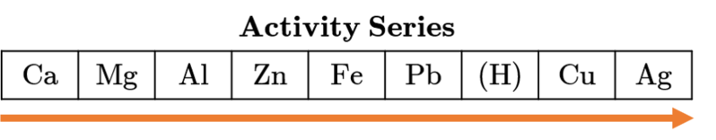
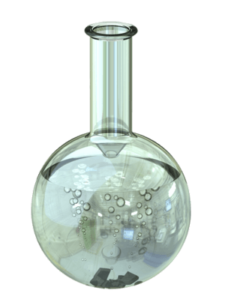
When metals react with dilute acids, they produce a metal salt and hydrogen gas, which can be seen as bubbles.
Metals that are more reactive than hydrogen on the activity series will react with dilute acids to some extent.
The name of the salt produced depends on the metal and the acid it is reacting with. Hydrochloric acid will form metal chlorides, and sulfuric acid will form metal sulfates.

Slide 5
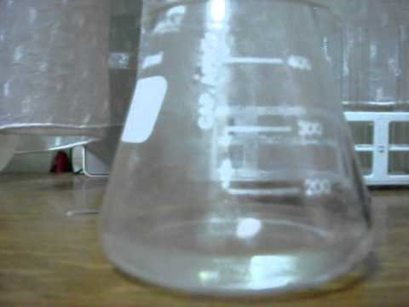

Slide 6


Slide 7
Aluminium reacts differently with dilute hydrochloric acid compared to dilute sulfuric acid.
With hydrochloric acid, the aluminium will appear to not react at first. This is because of its protective oxide layer. However, the hydrochloric acid will eventually remove this oxide layer. When the aluminium metal is exposed to the hydrochloric acid, a vigorous reaction will occur.
The protective oxide layer will not be removed by dilute sulfuric acid, so aluminium may not react with sulfuric acid unless the oxide layer is removed.

Slide 9
Zinc and iron will react with dilute acids relatively slowly, but the reaction can be seen by the bubbles of hydrogen gas that are produced.
Zinc will react faster than iron and may also cause a slight increase in temperature.

Slide 10
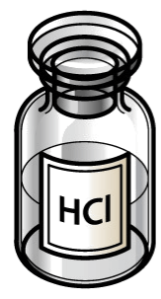
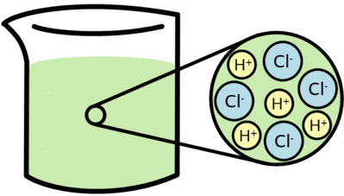
Metals react with hydrochloric acid to produce a metal chloride and hydrogen gas. The basic word equation for this reaction is:
metal + hydrochloric acid → metal chloride + hydrogen gas
Chloride ions have a −1 charge, and the formula of the metal chloride will be different depending on the charge of the metal cation.

Slide 11
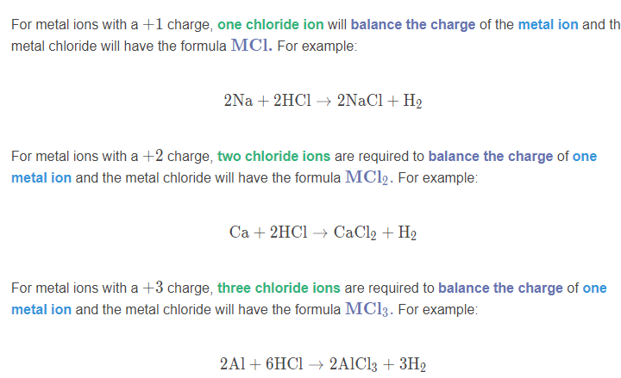

Slide 12
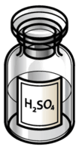
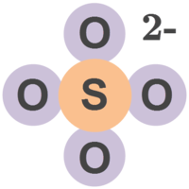
Metals react with sulfuric acid to produce a metal sulfate and hydrogen gas. The basic word equation for this reaction is:
metal + sulfuric acid → metal sulfate + hydrogen gas
Sulfate ions (SO_{4​}²⁻) have a −2 charge, and the formula of the metal sulfate will be different depending on the charge of the metal cation.

Slide 13
